Slide 1
PhD Thesis Monitoring System
Chirag Chandnani - 201501145
Dhruv Patel - 201501452
Mentor:- Prof. P M Jat

Slide 2
Objective
The project PhD Thesis Monitoring System fully supports all work flows required by student, thesis supervisor, dean AP and thesis reviewer in order to successfully monitor a thesis under review.
The current system requires to handle all the tasks manually, which are handled digitally on one platform through the PhD Thesis Monitoring System.

Slide 3
Use Cases Implemented
Student
Submit Synopsis
Submit Thesis
Sign up
Thesis Supervisor
Accept Thesis
Select Reviewer
Add/Edit Reviewer
View Reviews
Thesis Reviewer
Accept invitation for thesis review
Thesis whose review is pending
Show thesis details
Submit review

Slide 4
Use Cases Implemented
Dean AP
View thesis whose reviewers are selected
Send invitation to reviewer for thesis review
Accept reviewer for thesis review
Generate Username and password for reviewer
Send Notification for review pending
View review
Send review to supervisor
Send thesis to archives

Slide 5





Tools and Technologies

Slide 6
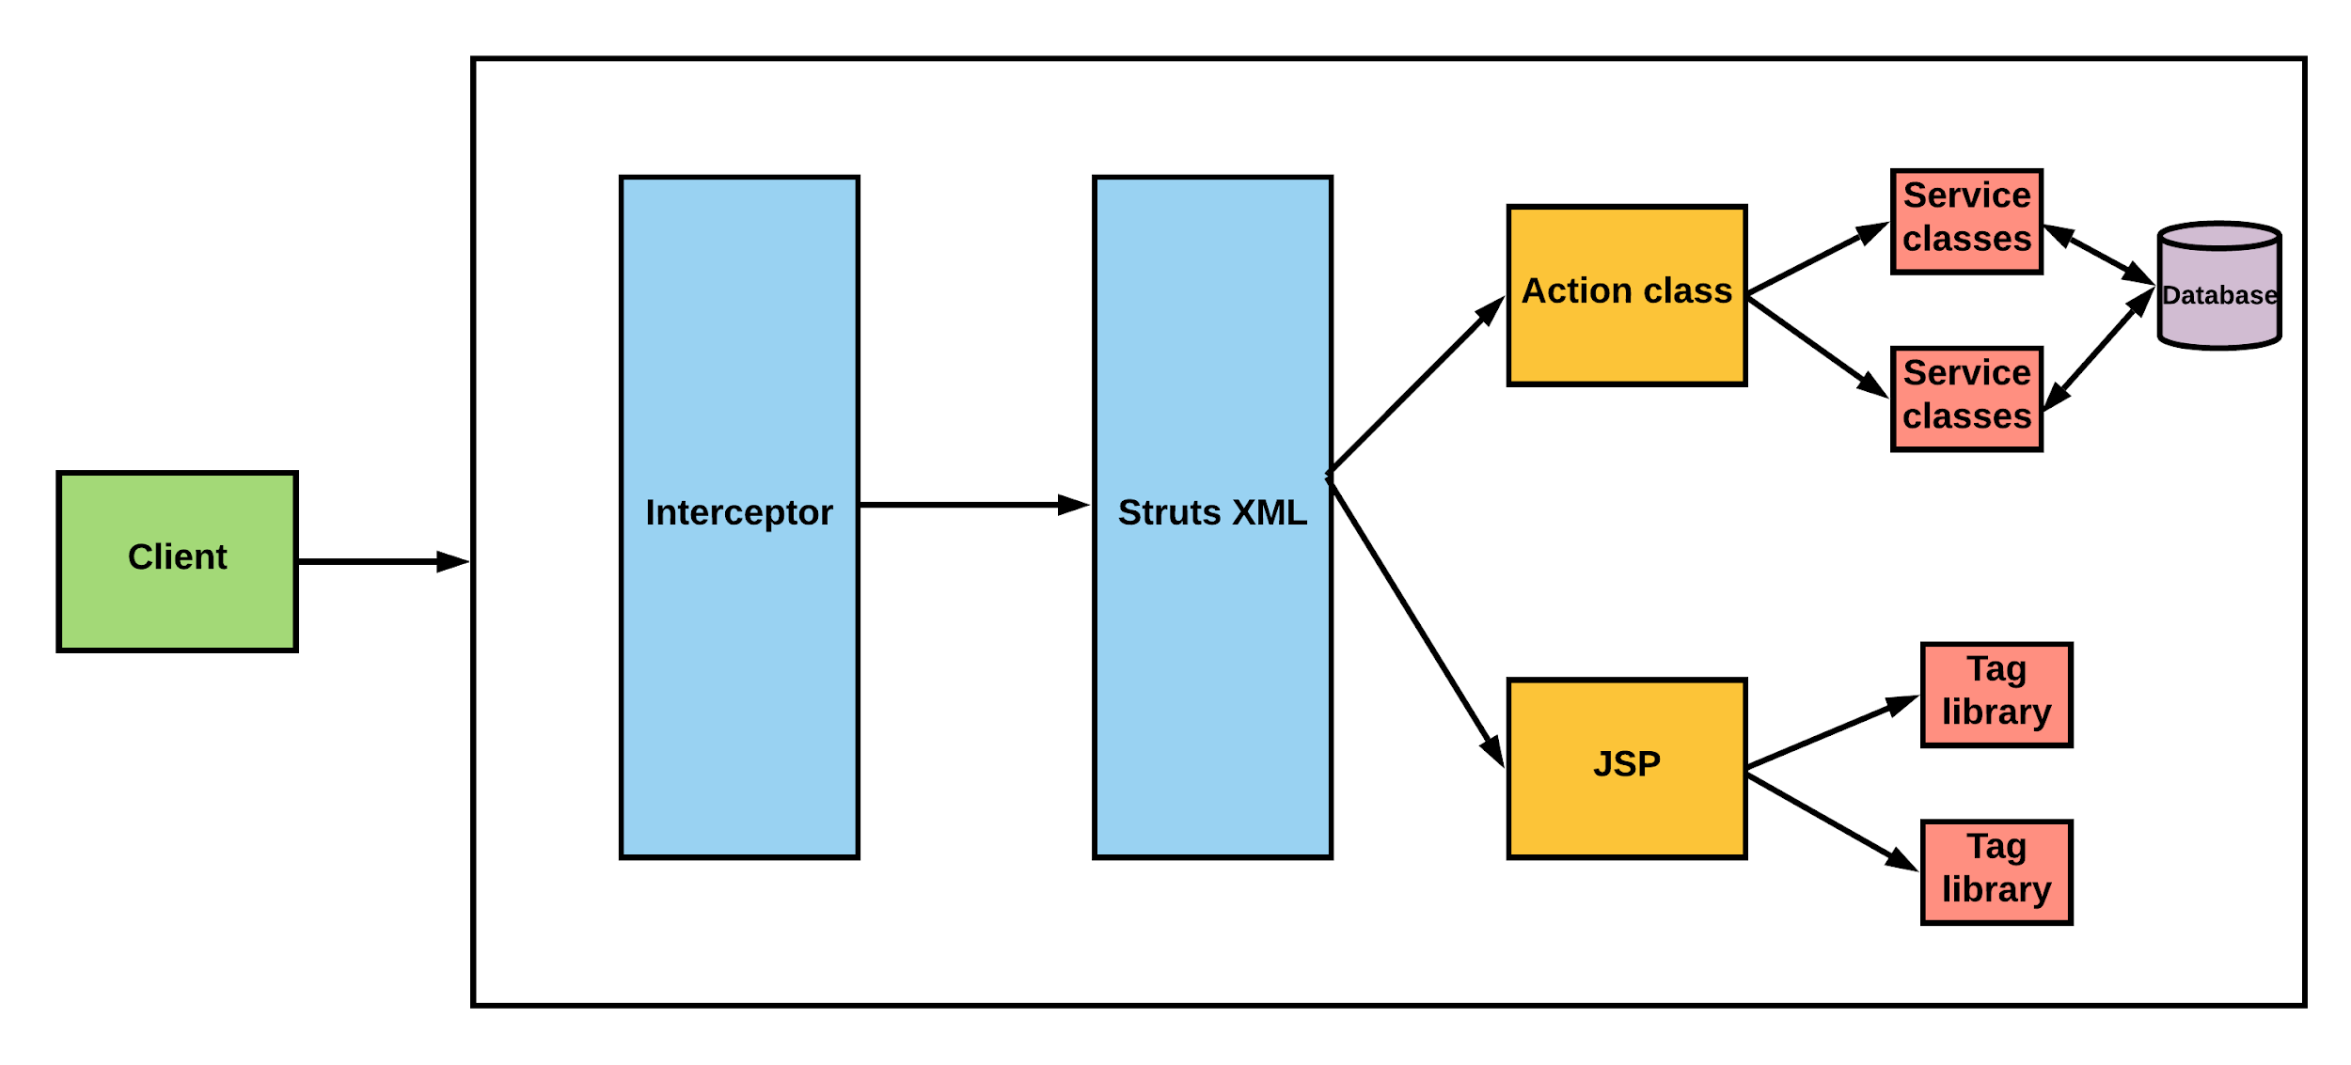
Architecture

Slide 7
Struts2
User sends a HTTP request for requesting some resource.
Configured interceptor functionalities applies such as validation, file upload etc.
Selected action(a java class) is performed based on the configuration specified in struts.xml and the action returns a string(result) which is mapped to a view(jsp page in our case)in struts.xml.
The result which is configured by the programmer is prepared by the view(a jsp page in our case) and the user sees the webpage.

Slide 8
Hibernate
Hibernate is an open source Java persistence framework project which implements the Java persistence API.
In Java persistence API, we define objects for each and every entity in the actual database and then there is a mapping between these real entities and classes in java so java can understand the database entities. This is called Object-Relational mapping(ORM).

Slide 9
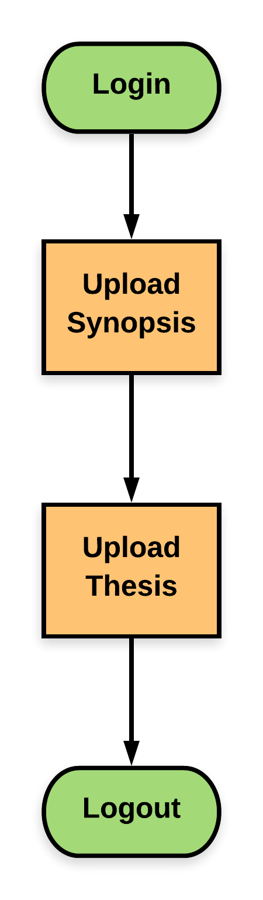
Student

Slide 10
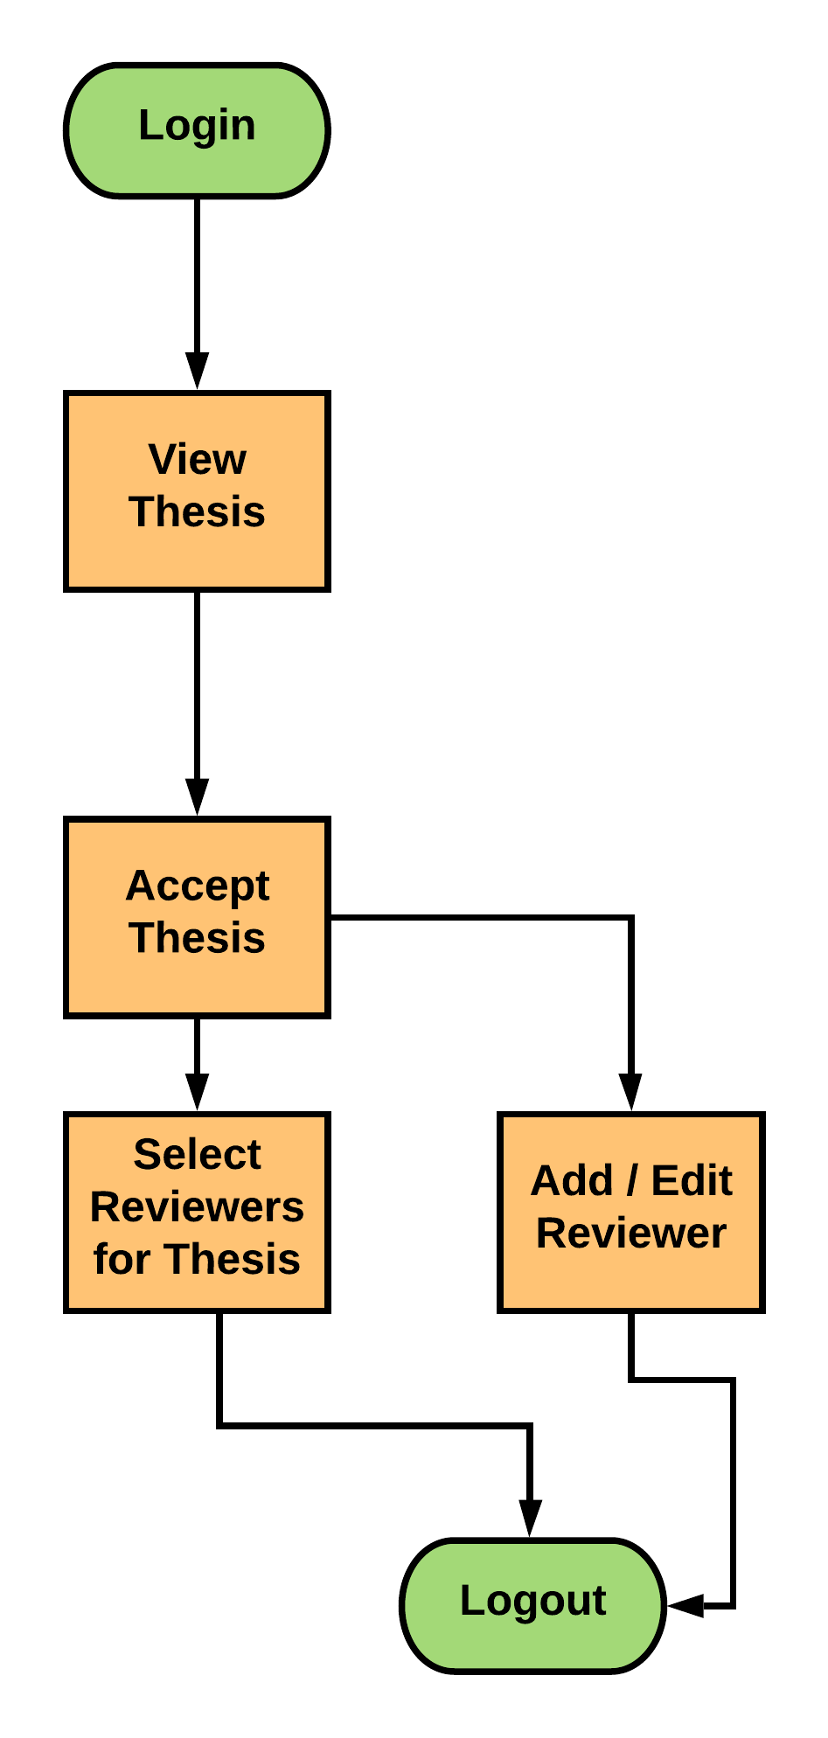
Supervisor

Slide 11
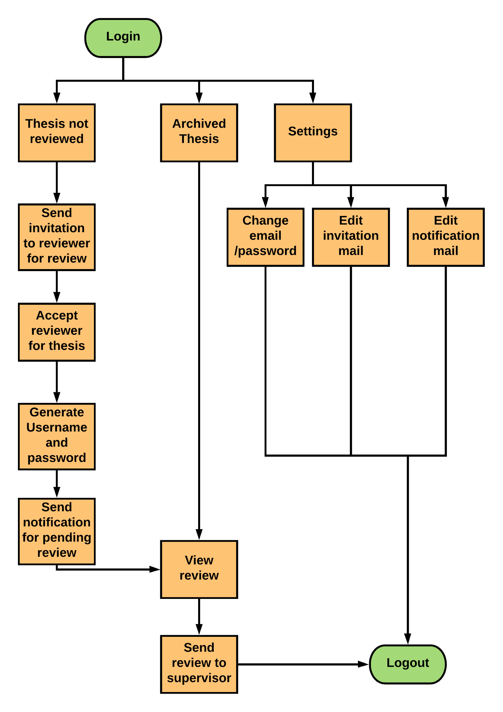
Dean

Slide 12
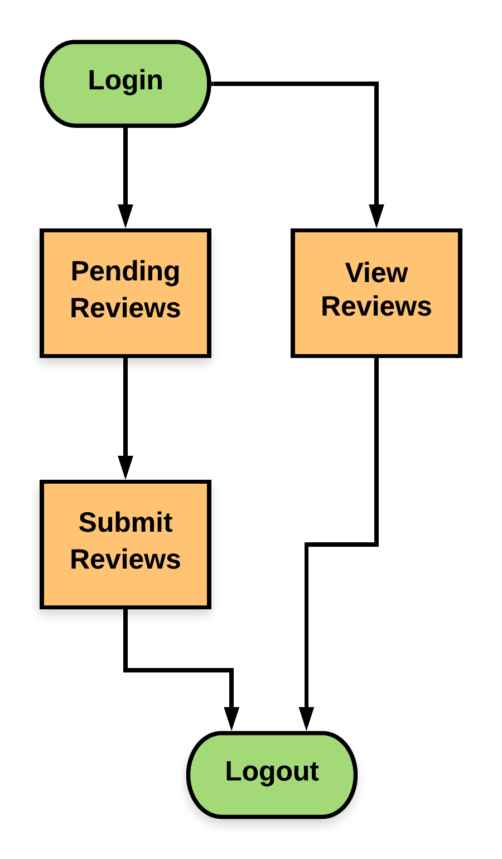
Reviewer

Slide 13
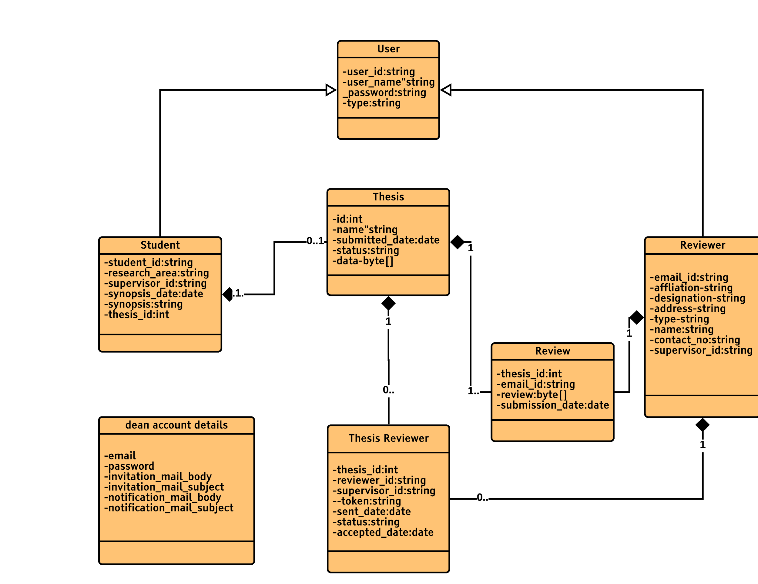
Class Diagram

Slide 14
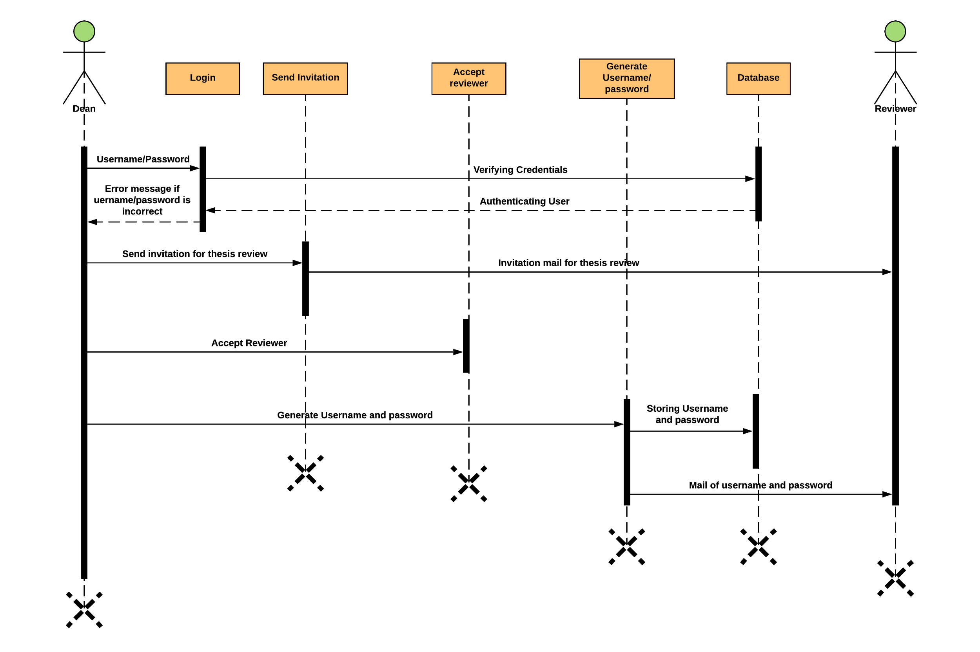

Slide 15
THANK YOU

